Slide 1
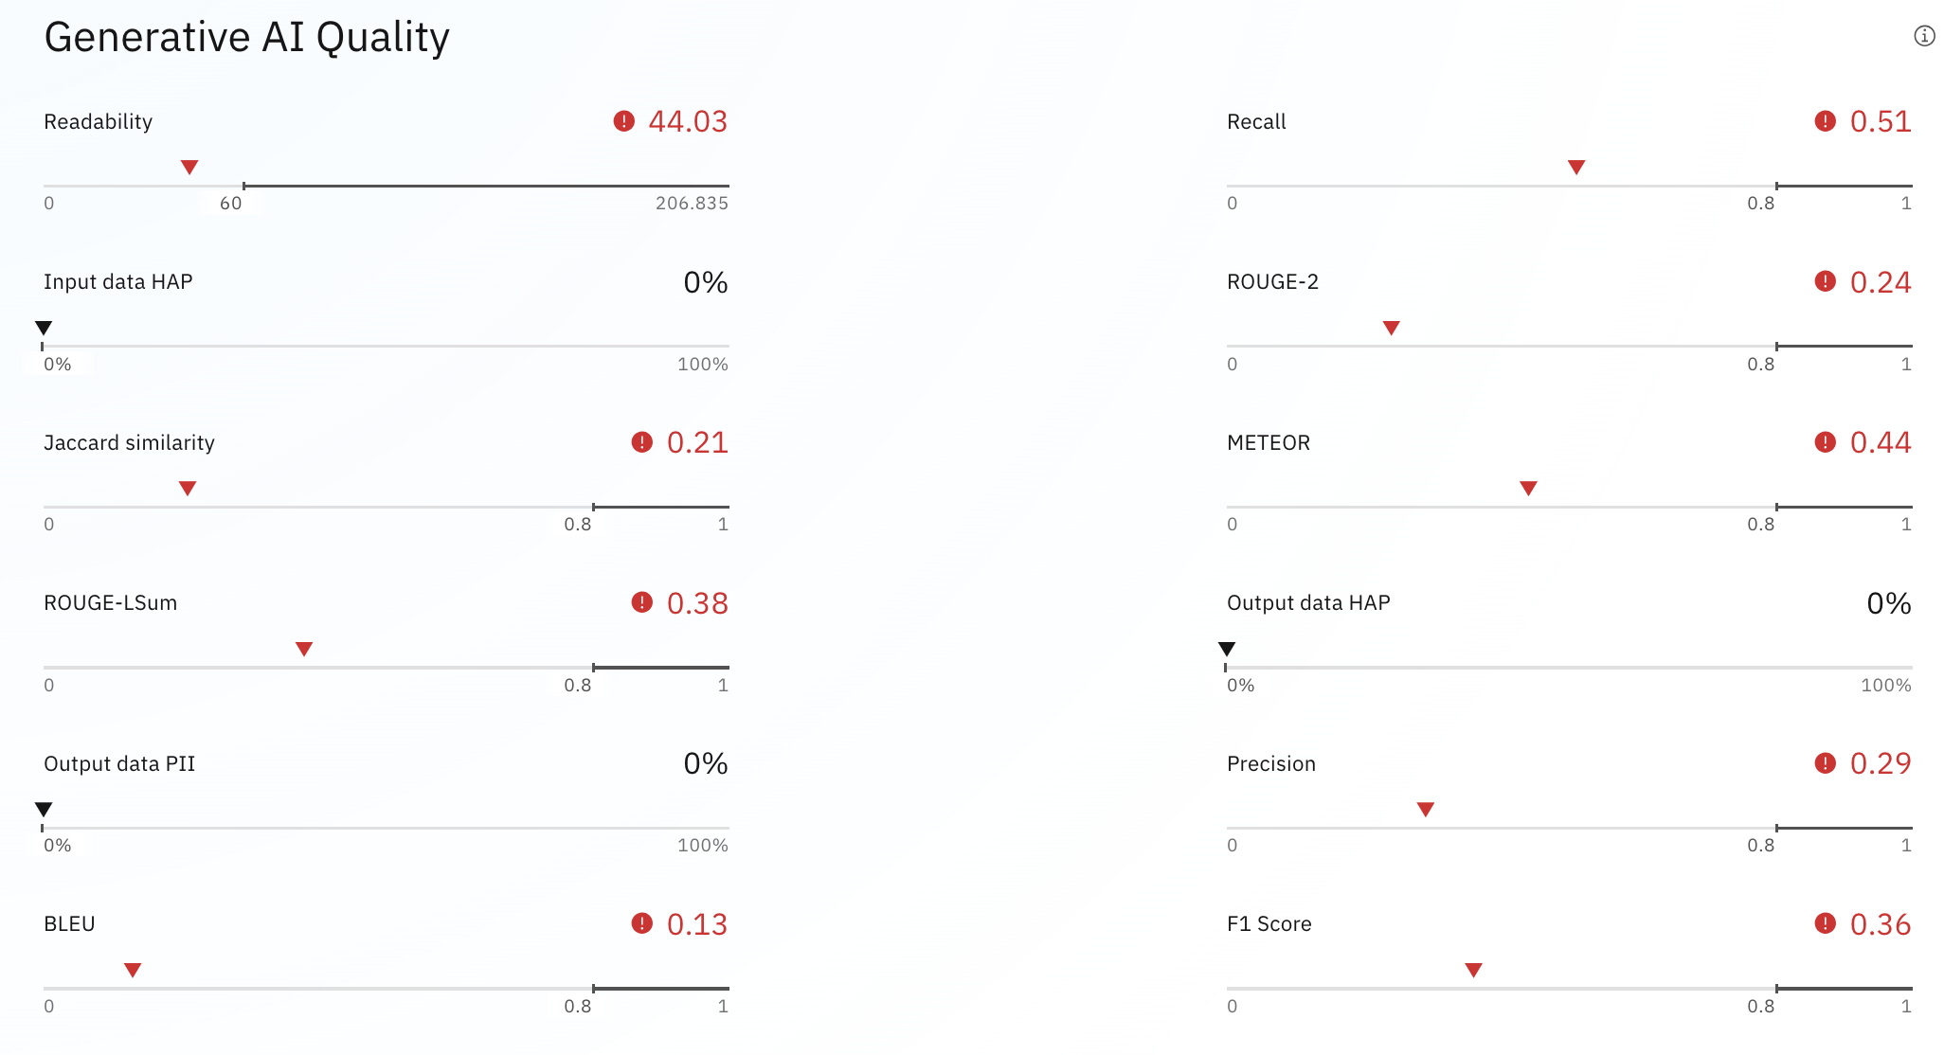
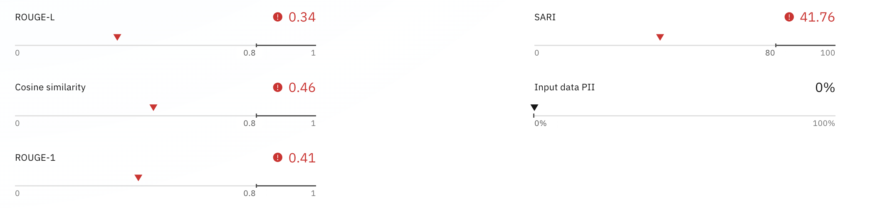
You are an insurance agent tasked to assess insurance claims. Summarize the following insurance claim input. Focus on the car and the damage. Make the summary at least 3 sentences long.
Sampling Method
max input = 25
max output = 150

Slide 2
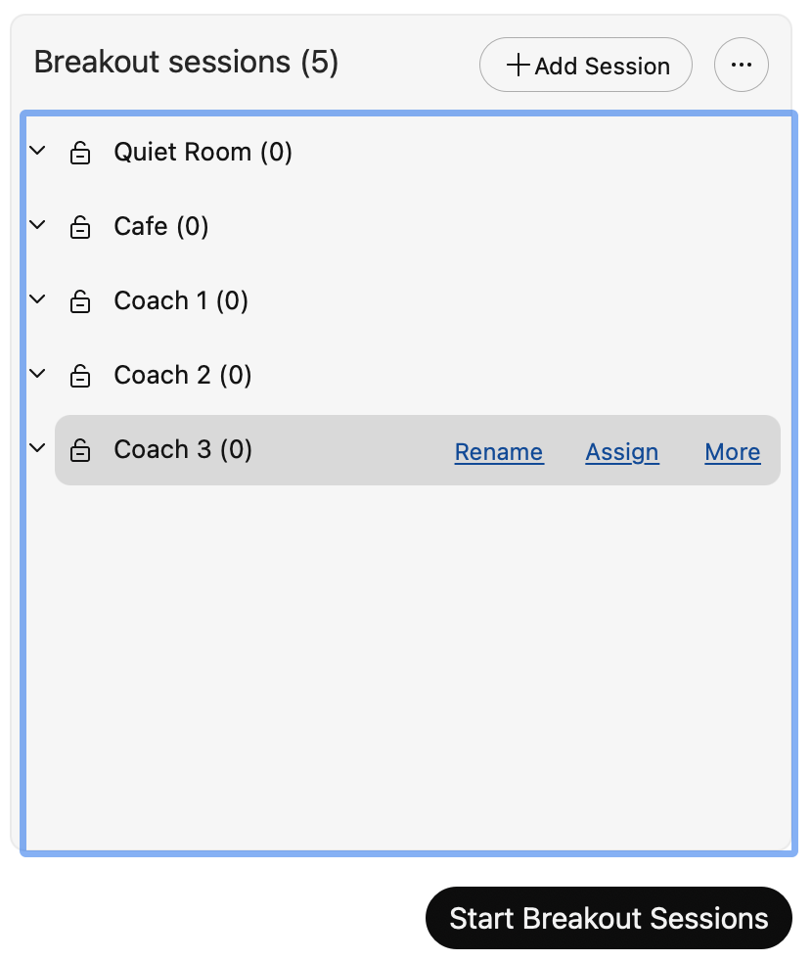

Slide 3
Workshop Labs Overview
Each lab build on the prior lab
Lab 0
Lab 1
Lab 2
Lab3
Environment Setup
Assisted prompt evaluation
Model monitoring
Automated monitoring
Accept invitation to environment on Tech Zone
Create Project
Create Inventory
Create a prompt template
Evaluate prompt against labeled data
View prompt performance metrics
AI Factsheets
Create a Use Case
Govern the lifecycle of your prompt templates
Deploy your prompt for Development
Deploy into Production
Monitor prompt performance
Use the watsonx.governance Python SDK to automate prompt monitoring.

Slide 4



Workshop Labs Architecture – Simplified
These are the systems and skills you will apply in the workshop
1
Tech Zone
watsonx.ai
Watson Machine Learning
11
Deployments Spaces
10
2
Model Evaluate and Monitor
4
Project
test and validation data
Prompt Builder
5
6
prompts
metrics
monitors
12
13
3
Inventory
8
7
9
use cases
AI Fact Sheets

Slide 5
Multi-Agent Architecture
Orchestration of multiple prompts and models
watsonx.ai
Virtual Assistant
Off Topic Helper
granite.13b.chat
user request
no
Reply as
off-topic
LLM Classifier
granite.13b.instruct
Is this request on-topic?
yes
Task Triage
granite.13b.chat
Triage in order to answer the question
R
A
G
corporate documents

Slide 6
Multi-Agent Architecture
Orchestration of multiple prompts and models
watsonx.ai
Virtual Assistant
Off Topic Helper
granite.13b.chat
user request
no
Reply as
off-topic
LLM Classifier
granite.13b.instruct
Request Validation
granite.13b. instruct
Is this request on-topic?
corporate backend systems
Extract and validate
required info
A
P
I
yes
Task Triage
granite.13b.chat
Triage in order to answer the question
structured language extraction
prompt-tuned model
Query Generation
granite.20b.code.instruct
Extract and validate
required info
R
A
G
query structured and unstructured databases
SQL
corporate documents
corporate
data

Slide 7

Prompt Workflow: Newsletter Summarization
Watson Discovery
watsonx.ai
Newsletter Article
Section Extraction
Section Summarization Prompt
sections

Slide 8
Prompt Workflow: Newsletter Summarization
Watson Discovery
watsonx.ai
Newsletter Article
Section Extraction
Section Summarization Prompt
sections
Summary of sections
watsonx.ai
watsonx.ai
watsonx.ai
Abstract Generator Prompt
On-Brand Editor Prompt
Abstract Brand Score Prompt
Final Abstract

Slide 9
Multi-Prompt Workflow: Newsletter Summarization
Watson Discovery
watsonx.ai
Newsletter Article
Section Extraction
Section Summarization Prompt
sections
Summary of sections
watsonx.ai
watsonx.ai
watsonx.ai
Abstract Generator Prompt
On-Brand Editor Prompt
Abstract Brand Score Prompt
Final Abstract
score < 4 then regenerate
watsonx.ai
reason
Abstract Re-Generator Prompt
watsonx.ai
watsonx.ai
Teaser Generator Prompt
Teaser Brand Score Prompt
2-3 sentence
brief teaser text

